Slide 1

ICT946 · CYBERSECURITY CAPSTONE · MIT SEMESTER 1, 2026
Ransomware Simulation & Recovery Strategies for Small Businesses
Restic
Duplicati
UrBackup
Group Members
Ajit Subedi Cihe241200
Maureen Gitau Cihe241111
Jiwan Kandel Cihe241170
Raju Shrestha Cihe241127
Supervisor: Assoc. Prof. John Ayoade

Slide 2
What this project is about
ABSTRACT
Problem
85%
SMBs face growing ransomware threats but lack tested, affordable recovery strategies.
of ransomware
attacks target SMBs
Approach
Safe virtual lab (VMware, Windows 10 + Ubuntu VMs) simulates a ransomware attack using a PowerShell script no real malware.
60%
Tools
Three open-source backup tools compared: Restic (CLI/snapshot), Duplicati (AES-256/GUI), UrBackup (server-client/dashboard).
of attacked SMBs
fail within 6 months
Metrics
Recovery Time Objective (RTO), data integrity via SHA256 hashing, and 100% file recovery rate measured for each tool.
31%
Outcome
cannot restore from
backup pay ransom
All three tools achieved full recovery at near-zero cost providing a replicable, evidence-based recovery framework for SMBs.

Slide 3
INTRODUCTION
(SMBs) are particularly vulnerable since attackers know they are more likely to have ineffective defences, fewer resources, and no trained IT security officers to fend off attackers.
Ransomware is no longer a large-enterprise problem, 85% of attacks now target small businesses.
The Threat
The Gap
Ransomware encrypts critical files and demands payment.
SMBs face average recovery costs of hundreds of thousands of dollars many never recover.
92% of SMBs have backups, yet 31% still cannot restore when attacked.
There is a critical gap between having a backup and knowing it works.
Our Approach
Our Value
We designed a safe, low-cost virtual lab using VMware.
Windows 10 victim machine, and an Ubuntu backup server no real malware, full isolation.
This project gives SMBs a replicable, evidence-based framework to test backup readiness before a real attack free to implement with existing hardware.

Slide 4




MOTIVATION & OBJECTIVES
Project Objectives
Goal:
To design, implement and evaluate effective backup and recovery strategies to protect small business data from ransomware attacks.
Design virtual lab
Safe VMware environment Windows as victim + Ubuntu server, host-only network
Configure 3 backup tools
Restic, Duplicati, UrBackup each fully set up and verified before the attack
Execute ransomware sim
Research Questions
PowerShell script renames all files with .locked extension, files inaccessible
RQ 1
How can an SMB safely simulate a ransomware attack using low-cost virtualization to test recovery without risk?
Restore & verify
Recover all files from each tool; verify with SHA256 hash comparison
RQ 2
Which backup tools Restic, Duplicati, or UrBackup most effectively restores critical data after a ransomware attack?
Compare & recommend
RQ 3
Measure RTO, integrity, usability provide evidence-based SMB guidance
What practical lessons from the simulation can improve SMB preparedness, RTO, and resilience?

Slide 5
LITERATURE & STATE-OF-THE-ART
Source | Topic | Key Findings | Relevance
Beaman et al. (2021) | Ransomware evolution | Advanced attack techniques | Need for practical recovery testing
Atetedaye (2024) | Defence strategies | Layered security approach | Supports backup + recovery
Batrel & Brahme (2023) | Backup techniques | Risks in backup systems | Compare different tools
Yin et al. (2023) | Backup vs ransom | Decision strategies | Recovery over ransom
Lehtinen (2023) | Tool comparison | Performance differences | Supports tool evaluation
Kim (2025) | Real-time detection | Faster detection improves recovery | Highlights RTO importance
★ GAP IDENTIFIED: No prior study directly compares Restic, Duplicati & UrBackup under identical ransomware conditions. This is our original contribution.

Slide 6

METHODOLOGY & SYSTEM ARCHITECTURE
HOST MACHINE Windows PC (VMware Workstation)
EXPERIMENT FLOW
Windows 10 VM
=
Ubuntu 22.04 VM
1
Create 75-file business dataset
VICTIM
BACKUP SERVER
2
Configure & verify all 3 backups
• 2 vCPUs · 4 GB RAM · 40 GB
• 1 vCPU · 2 GB RAM · 20 GB
3
host-only
network
Take baseline snapshot
• C:\small business files
• IP: 192.168.31.141
• 75 files = 408 MB
4
Execute PowerShell attack (.locked)
• UrBackup Server 2.5.36
• Restic + Duplicati client
5
• Samba share (Duplicati)
Restore from each backup tool
• UrBackup client
• VMware shared folder
6
Measure RTO + SHA256 verify
• PowerShell attack script
• (Restic repository)
7
Analyse, compare & recommend

Slide 7





DATA COLLECTION & ANALYSIS
Ransomware Attack
METRICS COLLECTED
Business Dataset
Pre-Attack Backup
PowerShell all files
become .locked
75 files · 408 MB
CSV, PDF, audio, payroll
All 3 tools take
clean backup snapshot
Recovery Time (RTO):
Linux time command exact seconds from restore start to finish
File Recovery Rate:
Attack Verified
Restore & Measure
Integrity Check
find 75/75 files confirmed after each restore
Files confirmed
inaccessible
Restore from backup
Record RTO
SHA256 hashing
zero differences
Data Integrity (SHA256):
sha256sum diff: original vs restored = zero differences
Backup Storage Size:
Actual MB stored per tool on the Ubuntu backup server
ATTACK SCRIPT
Get-ChildItem "C:\small business files"
-Recurse -File | Rename-Item
-NewName { $_.Name + ".locked" }

Slide 8
IMPLEMENTATION & RESULT ANALYSIS
Restic
Duplicati
UrBackup
⚡ FASTEST
🔒 AES-256
🖥 MANAGED
RTO
RTO
RTO
7.503sec
< 1 min
< 1 min
CONFIG
CONFIG
CONFIG
• CLI · v0.18.1 · Windows
• Web GUI · AES-256 encrypted
• Server 2.5.36 on Ubuntu
• Repo: C:\resticrepo → Ubuntu VMware share
• Dest: \\192.168.31.141\DuplicatiBackup
• Web UI: http://192.168.31.141:55414
• Password-protected · Snapshot d5ede1d9
• Samba share · 100 MB volumes
• Full file backup · 383.57 MB
RESULTS
RESULTS
RESULTS
✓ 75/75 files · 100% rate
✓ 75/75 files · 100% rate
✓ 75/75 files · 100% rate
✓ SHA256: zero differences
✓ SHA256: Zero differences
✓ Hash comparison: PASSED
✓ Restore cmd: restic restore latest
✓ Strongest encryption of all three
✓ Smallest backup footprint
Recovery Time (seconds) — Restic 6× faster

Slide 9
TESTING & DEPLOYMENT
File Count Verification
SHA256 Data Integrity
✓ find | wc -l on original folder → 75 files
✓ sha256sum on originals → original_hashes.txt
✓ Same command on each restored folder → 75/75
✓ sha256sum on restored → restored_hashes.txt
✓ 100% count match confirmed across all three tools
✓ diff output: empty (zero lines) = perfect match
RTO Measurement
Safety & Isolation Validated
✓ Restic: Linux time command → 7.503 seconds
✓ Host-only VMware -- no internet during attack
✓ Duplicati & UrBackup: log timestamps same minute
✓ PowerShell script only — zero real malware
✓ All tools met the SMB target of < 1 minute
✓ VMware snapshots enable instant rollback
DEPLOYMENT: Fully replicable open-source only, runs on a single standard laptop, zero software cost. Any SMB can reproduce this framework today.

Slide 10




ETHICAL ISSUES & LIMITATIONS
✓ ETHICAL CONDUCT
⚠ LIMITATIONS
No Real Malware:
Lab Production:
PowerShell script only renames files, no encryption. Zero malware risk at any stage.
VMware VMs differ from physical hardware; speeds won't match real SMB environments.
Full Isolation:
Small Dataset (408 MB):
Host-only VMware network, no internet.
Real SMBs may have TBs of data. RTO will scale significantly at larger volumes.
Dummy Data Only:
All synthetic test files no real personal or business data used.
File-Rename Only:
Real ransomware encrypts, exfiltrates, and spreads laterally not simulated here.
Open-Source Attribution:
No IDS/SIEM Layer:
Restic (MIT), Duplicati (LGPL), UrBackup (AGPL) all properly cited.
No intrusion detection alongside backups full incident response not evaluated.
Honest Reporting:
Single Run Per Tool:
All failures and limitations documented no results inflated.
Reliability not confirmed over multiple runs. One success consistent performance.

Slide 11
CONCLUSION AND RECOMENDATION
All three tools succeeded.
Choose based on your SMB's priorities.
Restic
Duplicati
UrBackup
BEST FOR SPEED
BEST FOR SECURITY
BEST FOR MANAGEMENT
~7.5 sec RTO · CLI · Snapshot
For tech-savvy IT admins
AES-256 · Web GUI
For non-technical SMB users
Web dashboard · Server-client
Multi-machine centralised control
KEY FINDINGS: ✓ 100% file recovery (all tools) ✓ Restic fastest: 7.5s RTO ✓ SHA256: zero data corruption ✓ Open-source = zero licensing cost ✓ Isolated backups survived attack
✓
Use Restic when sub-10-second RTO is critical (tech admins)
✓
Use Duplicati for AES-256 protection + non-technical users
✓
Use UrBackup for multi-machine centralised SMB management
✓
Always keep backups isolated/offline from production network

Slide 12
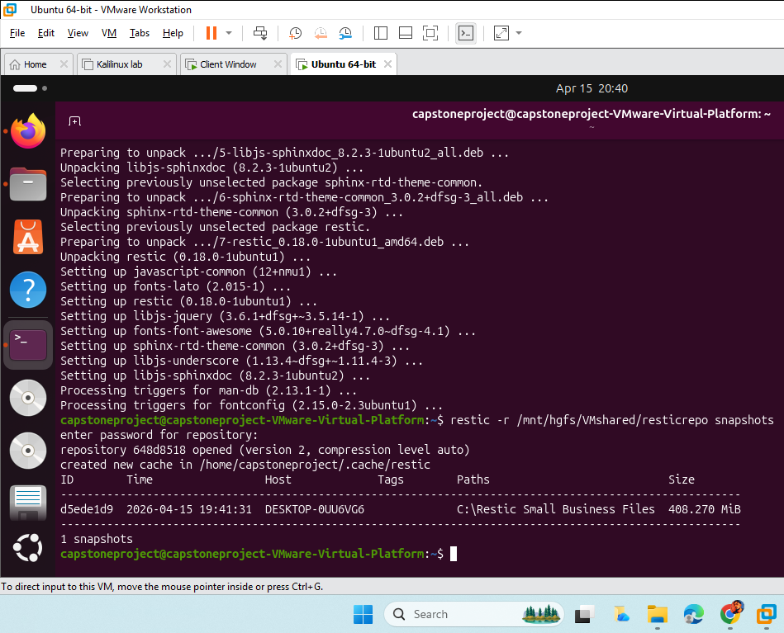
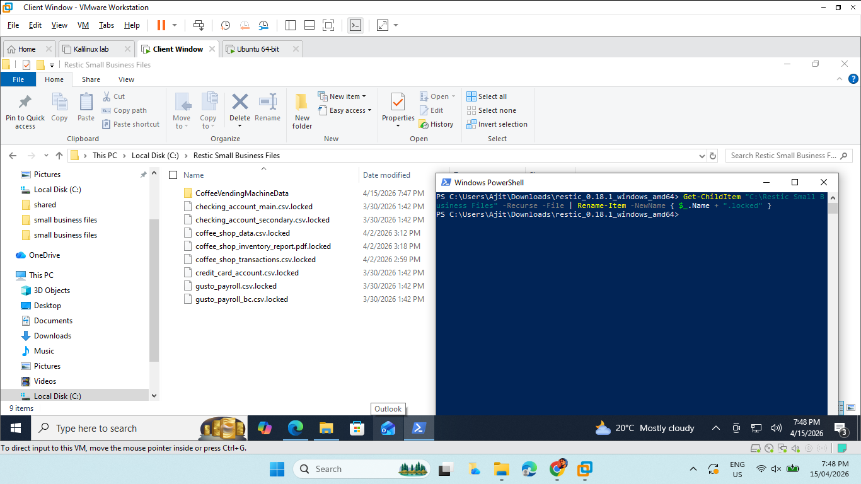
IMPLEMENTATION SCREENSHOTS –VISUAL EVIDENCE
Restic
Fig1: Checking snapshots which was shared from windows to ubuntu for backup
Fig 2: Ransomware on Original files which are found to be .locked extensions.

Slide 13
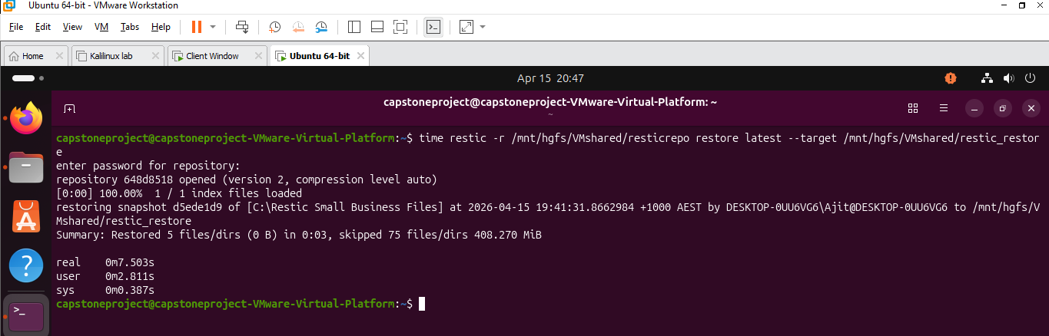
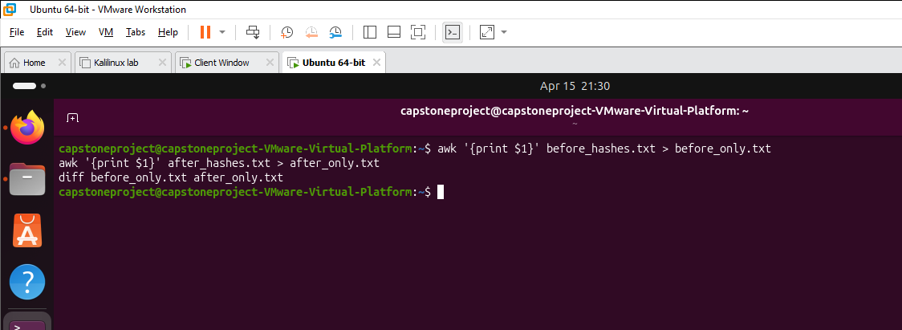
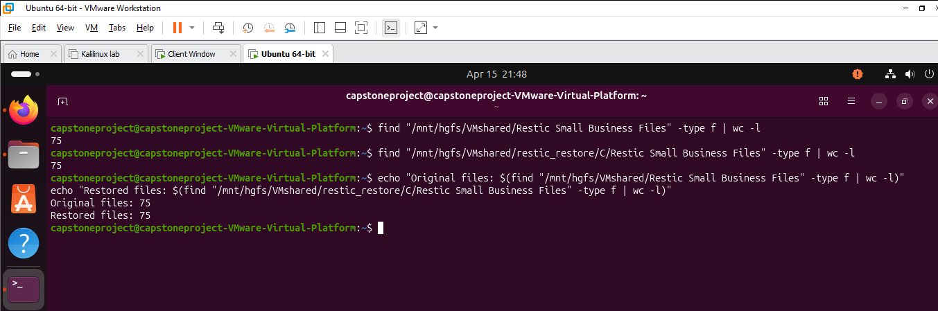
Fig 3: Restore process and timing check
Fig 4: Check the hash Value for both original files and restored files.
Fig 5: Comparing the no of files on both the original folders and Restored folders.

Slide 14
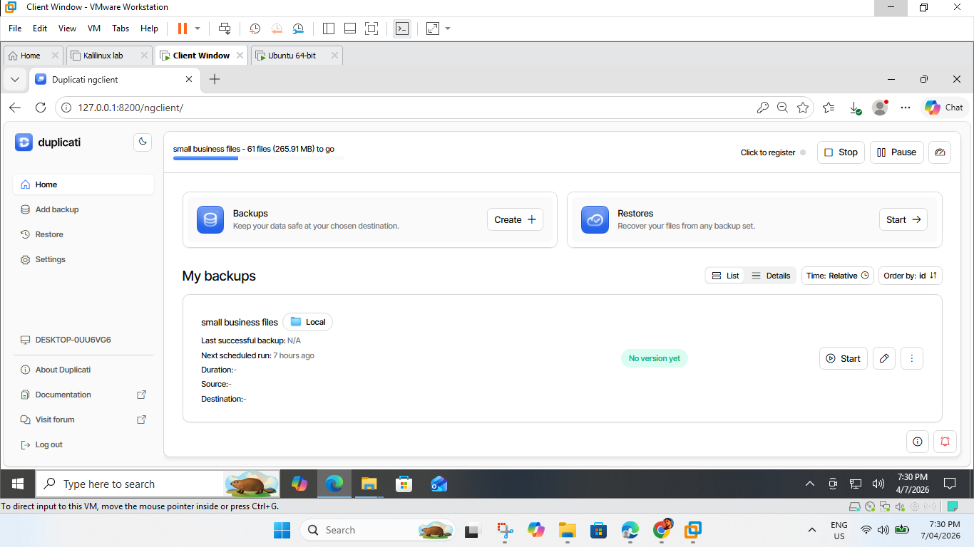
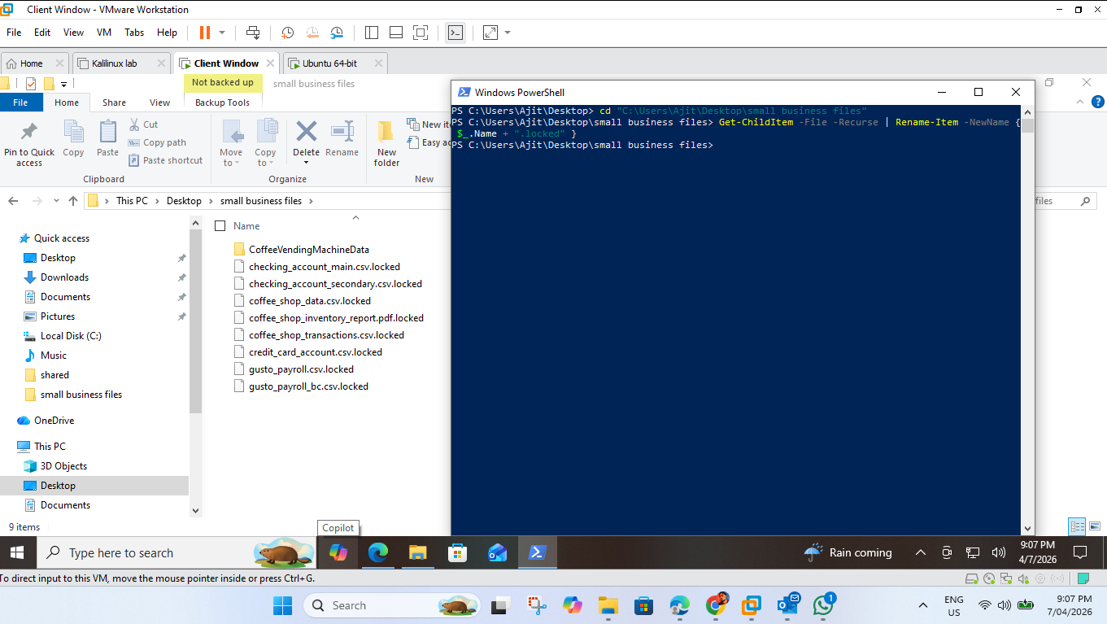
Duplicati
Fig 6: backing up the files from windows in duplicati
Fig 7: Run a ransomware and files are with .locked extension.

Slide 15
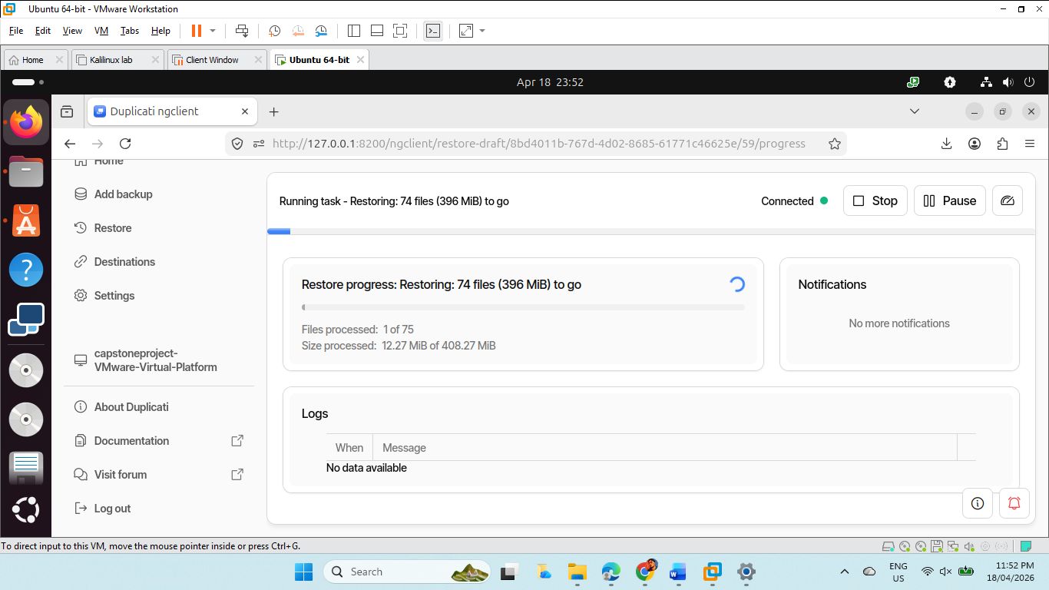
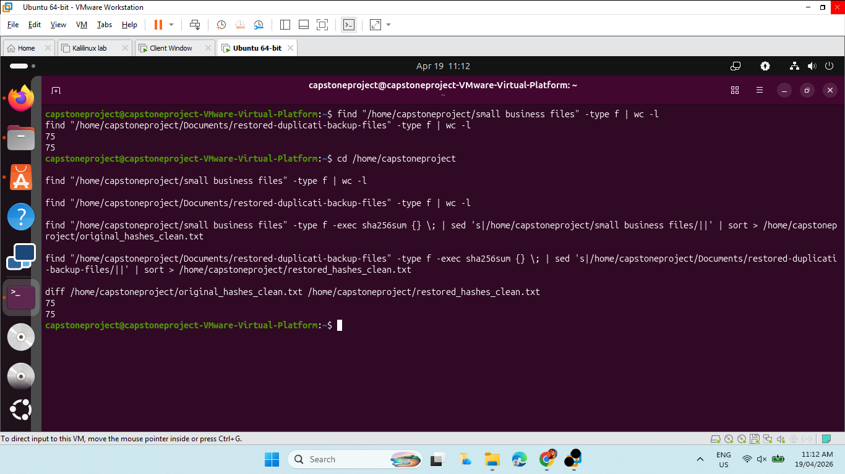
Fig 8: Restoring process in ubuntu dublicati server
Fig 9: we compared both the file's , Restored files are identical with original files.png

Slide 16
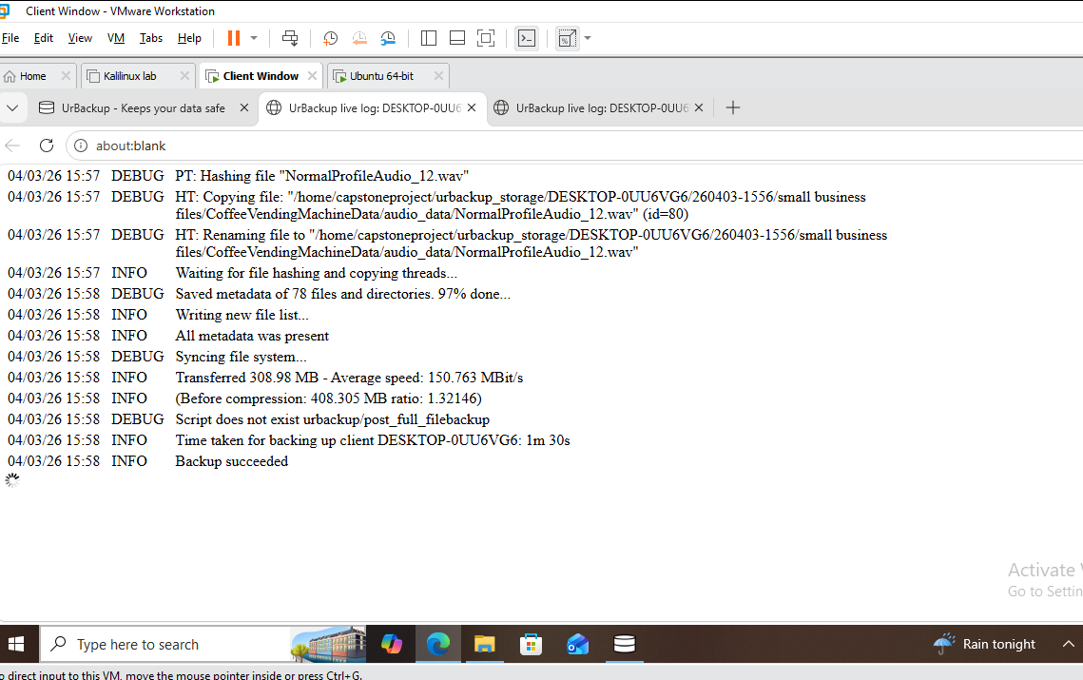
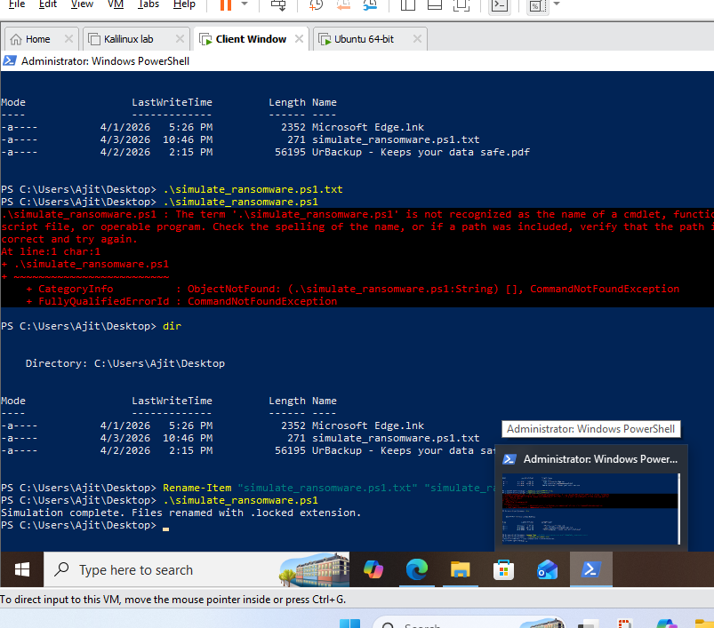
Urbackup
Fig 10: Files backup successfully and then shared to ubuntu via shared folder.
Fig 11: Evidence for ransomware and files with .locked extension.

Slide 17
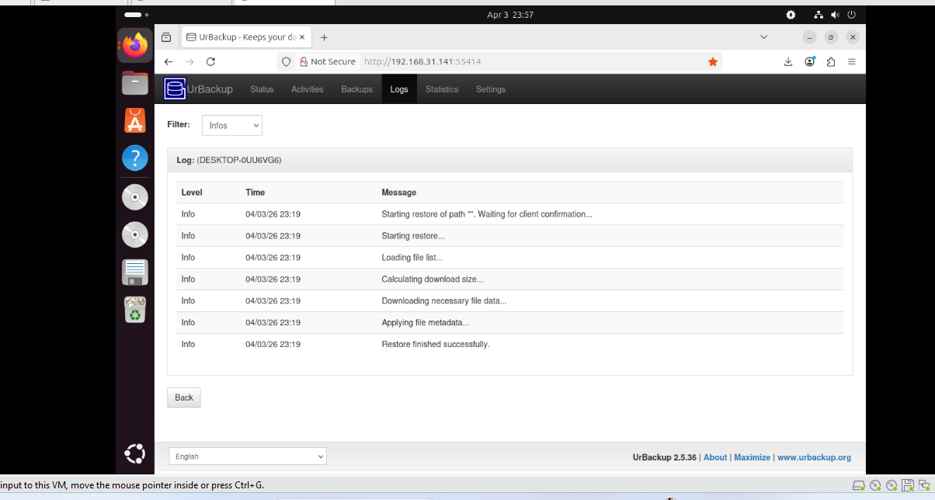
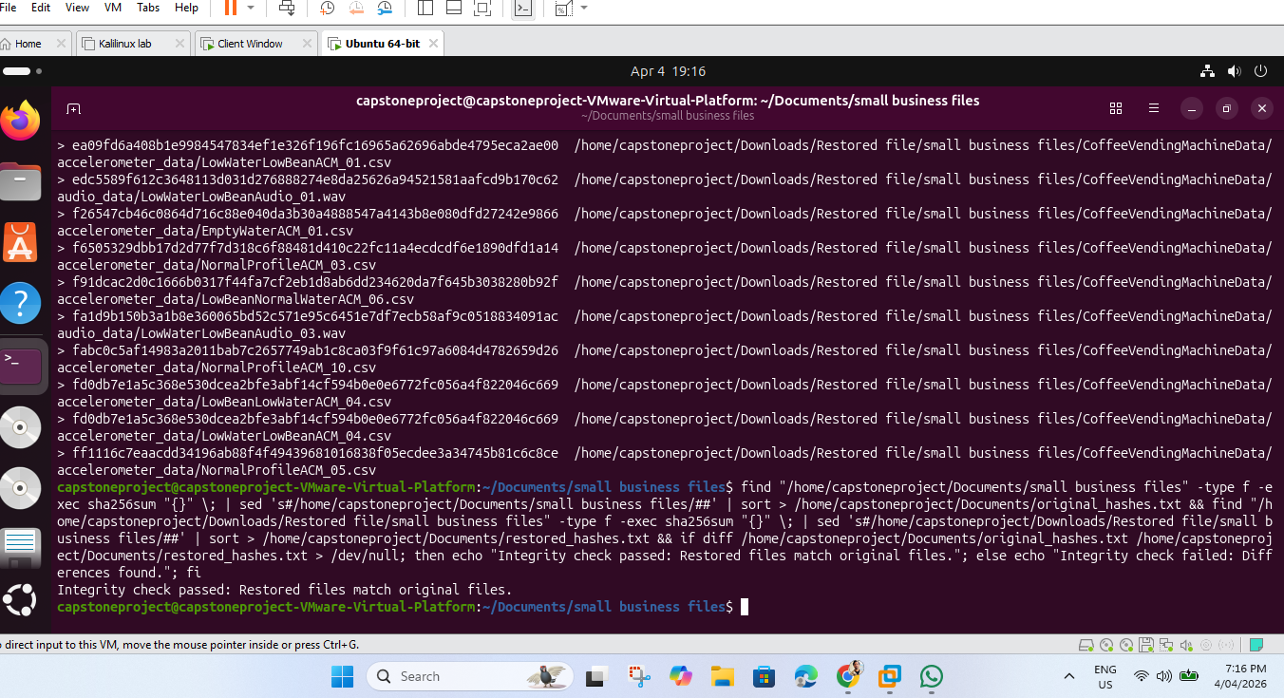
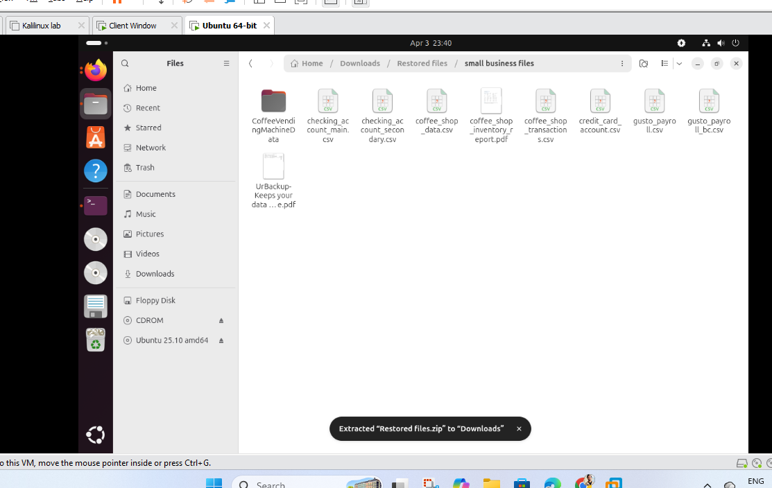
Fig 14: Creating a hash value and comparing the file integrity which was found to be passed.
Fig 12 and 13 : Files are restored successfully in ubuntu

Slide 18
THANK YOU

